Slide 1
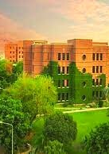
LUMS ATM Optimization
DISC 212-S1 GROUP 5

Slide 2
Problem
Students complain about inefficcient ATM's in LUMS:
  Superstore ATM fixed timings
  Frequent traffic at PDC ATM
  SDSB and SAHSOL ATM's often underused and inconvinient.
Our model aims to place a new ATM in LUMS that would maximise utility while being optimally distant from existing ATM's

Slide 3
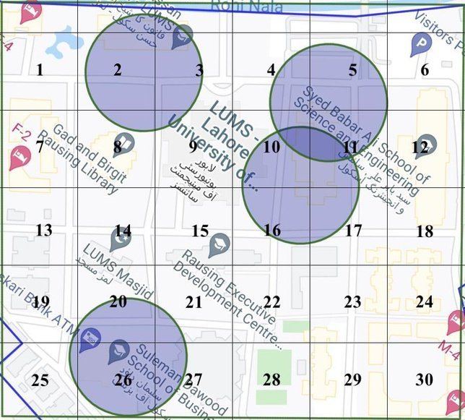
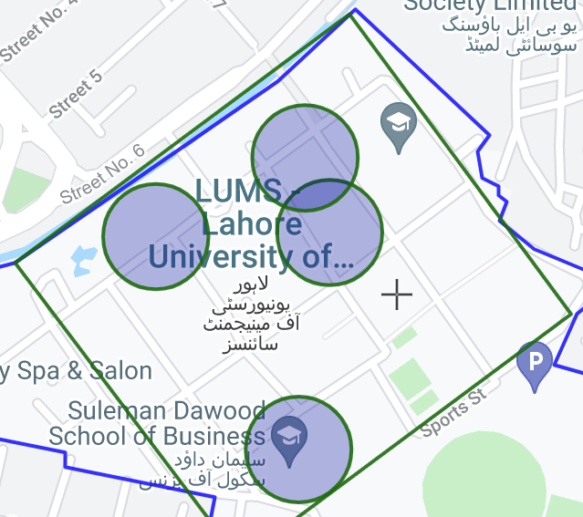
  13 hotspots were identified where ATMs at LUMS did not exist, through an extensive survey
  With google maps, dimensions of the selected area were determined. It measures 460m x 420m
  A simplified grid of 30 boxes was created, which measures 84m x 76m respectively
Data
1) MCLP model
2) Survey

Slide 4
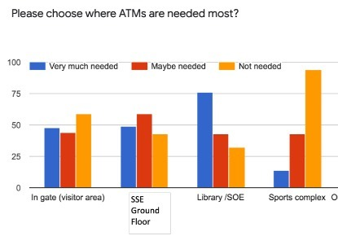
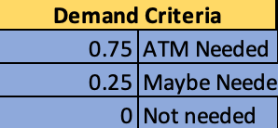
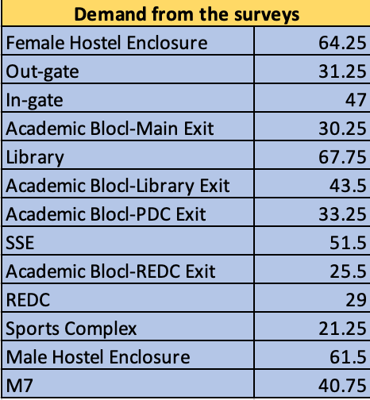
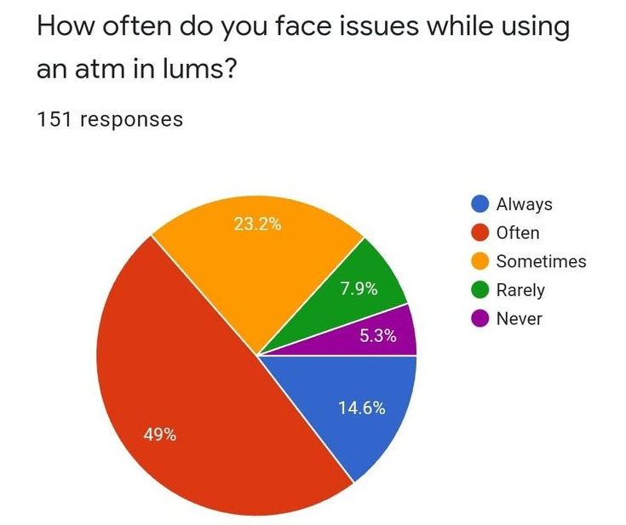
Data Analysis

Slide 5
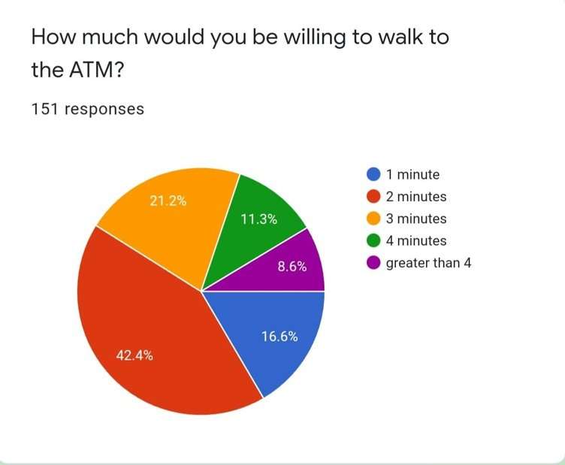
  LUMS and the Vendor equally bear the initial and monthly costs
  The additional cost of setting up an ATM outside building(s) is negligible
  The radius for a single atm to be 150m, considering the preferred walking time of 2 mins
  Hotspot spread in different nodes (grid boxes) - Demand is the same for such nodes (grid boxes)
  Demad is aggregated at the centre of each node (grid box)
Assumptions

Slide 6
Decision Variables
Objective Function
Yi = 1 if grid box has an existing ATM
Yi = 0 if not
Xi = 1 if grid box is covered
Xi = 0 if not
MAX 64.25Y1 + 0Y2 + 30.25Y3 +30.25 Y4 +0Y5 . . . . + 61.5Y30
Y= NODE IDENTIFIED ON THE MAP
Constraints
  CONSTRAINTS FOR THE LOCATION OF ATM- NOT EQUIVALENT TO ZERO WITH EXISTING ATM’S
  MCLP CONSTRAINTS
  THE TOTAL NO. OF ATMS IS 5

Slide 7
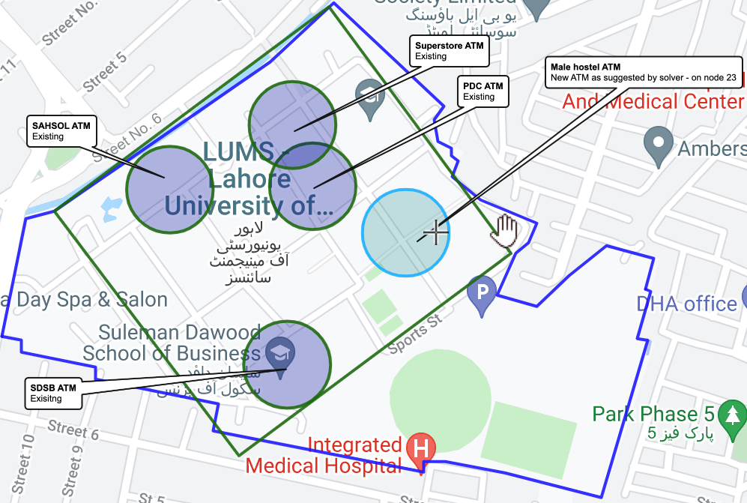


Final Recommendation
Placement of new ATM Outside Male hostel enclosure
= New ATM

Slide 8

Insights
The solver initially gives us an unfeasible solution because the objective is to maximise utility while also taking into account the distance constraints put forth by the MCLP constraints.
This not only places it at a distance not overlapping with the existing ATMS, but also takes into account the maximisation of utilitly.
Solver then gives us the recommendation to place it in one of the boxes around the male hostel area.

Slide 9
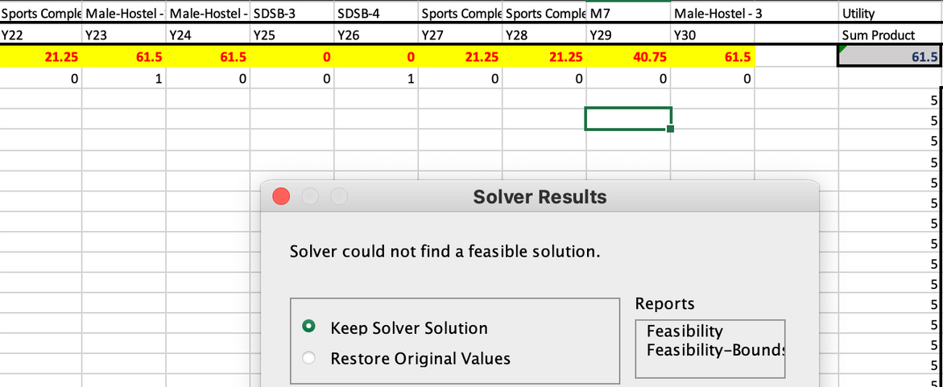
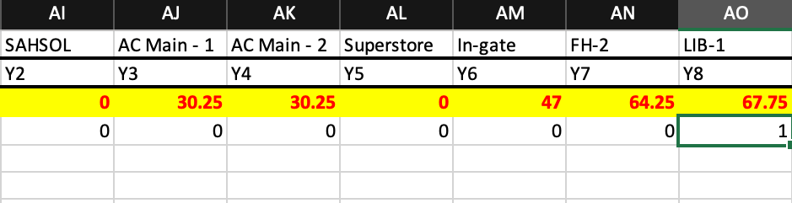

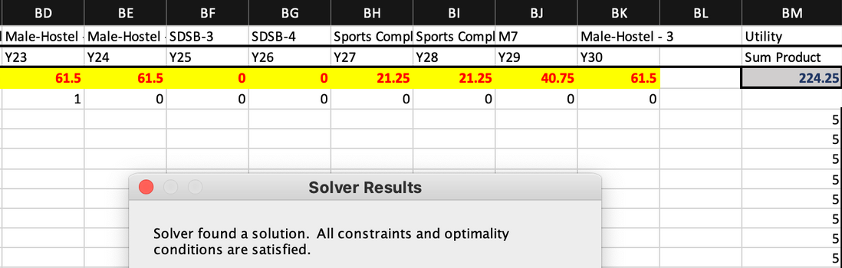
Original Solution
Alternate Solution
The alternate answer in which solver displays feasible solution in which existing units (ATM's) can be moved around to maximise demand and coverage as shown in the optimal solution. Investment is not fixed with additional costs of relocating existing ATM's. (Solver relocates SAHSOL ATM to Library node and adds additional ATM to Male Hostel node)
The original answer in which solver displays infeasible solution since the existing units (ATM's) are fixed in the MCLP model. Investment is fixed with cost of one additional ATM. (Solver adds additional ATM to Male Hostel node)

